Slide 1

Artificial Intelligence and Machine Learning
Logistic Regression

Slide 2
Lecture 2: Outline
Linear Regression (Review)
Logistic Regression (Classification)
Optimization

Slide 3
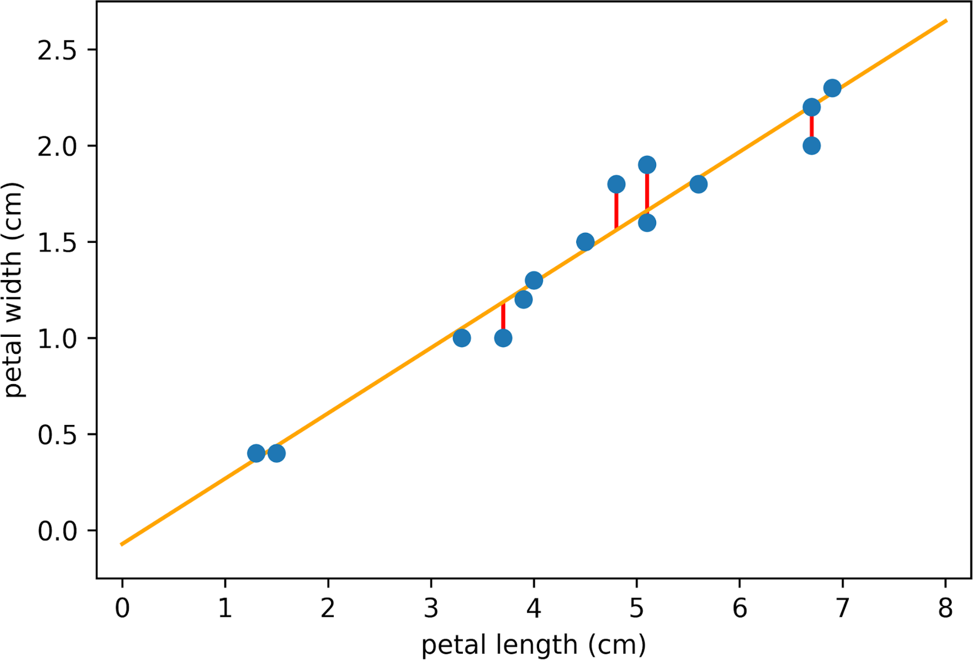
Recap
Design your model
Input scalar linear model (line fitting)
Fitting polynomials (synthetically designing features from a one-dimensional input)
Design your loss function
We used mean squared error loss throughout
Finding optimal parameter fitting
Closed form solution to the linear least squares?
Why is it linear least squares?
Solution is closed form

Slide 4
Logistic regression or Classification

Slide 5
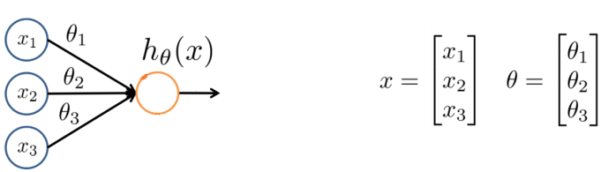
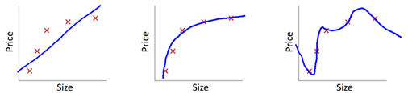
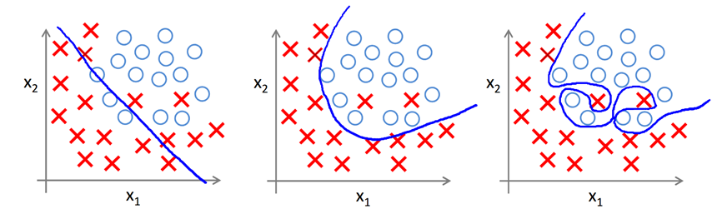
Regression VS classification
Regression (linear and polynomial): for prediction
Classification:
Notes:
Classification predicts discrete label values while regression predicts continuous numerical values

Slide 6
Regression VS classification
Income prediction -> regression
Male or Female -> classification
House price -> regression
Spam detection -> classification
Image recognition -> classification
Notes:
Classification predicts discrete label values while regression predicts continuous numerical values

Slide 7
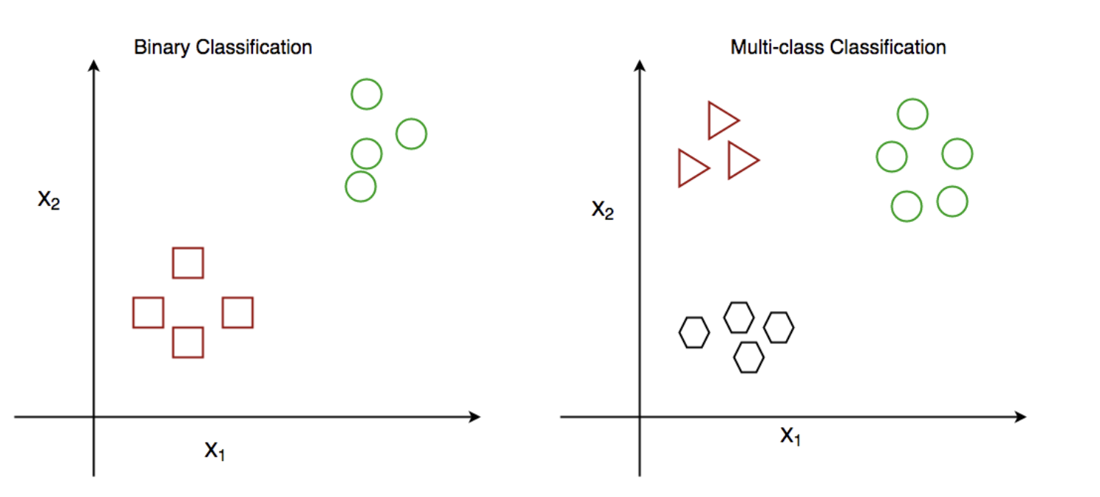
Classification
Notes:
Classification predicts discrete label values while regression predicts continuous numerical values

Slide 8
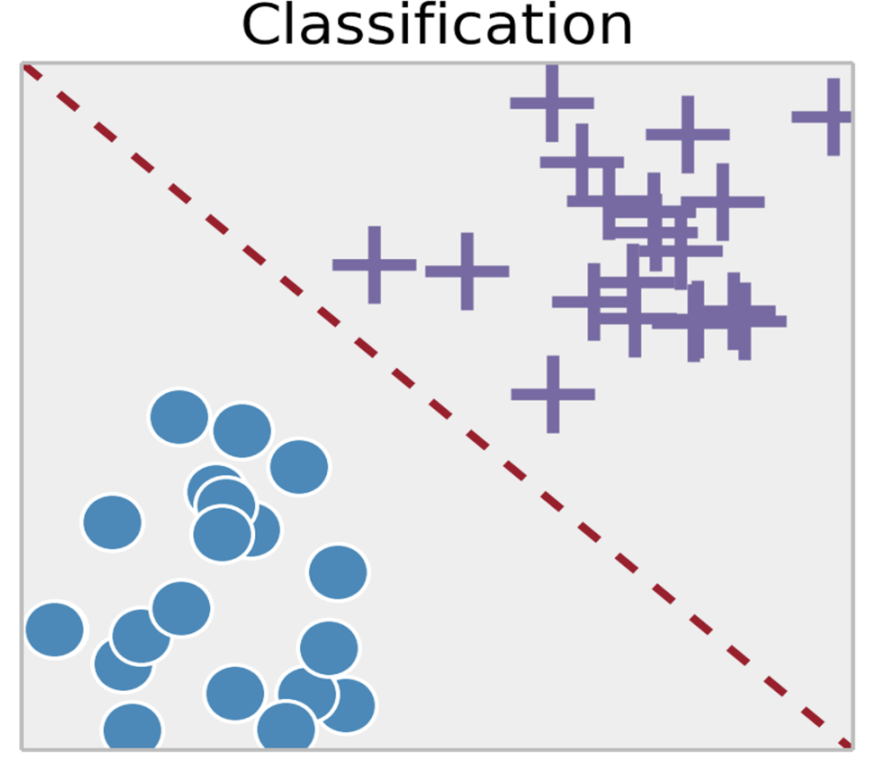
Logistic Regression
Regular vs Fraudulent transaction
Spam vs Non-spam emails
Benign vs Malignant tumors
Rising vs Falling stocks

Slide 9
Logistic Regression vs linear regression
Linear Regression | Logistic Regression
For Regression | For Classification
We predict the target value for any input value | We predict the probability that the input value belongs to the specific target
Target: Real Values, continuous values | Target: Discrete values
Graph: Straight Line | Graph: S-curve

Slide 10
Logistic Regression
Despite the name, logistic regression is a
classification algorithm
Logistic Regression is a linear model with a “special function” that helps us use this linear model for classification

Slide 11
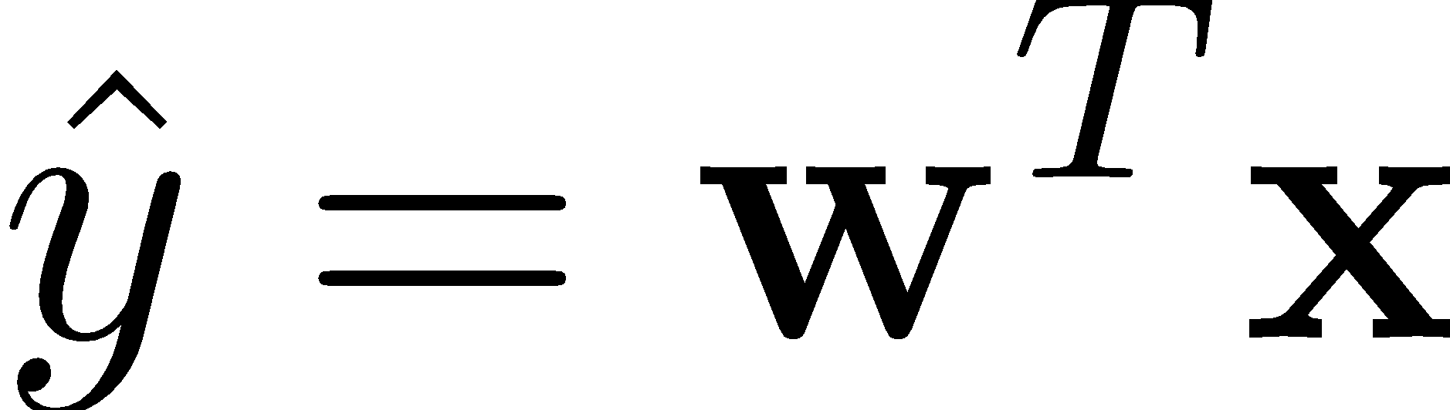
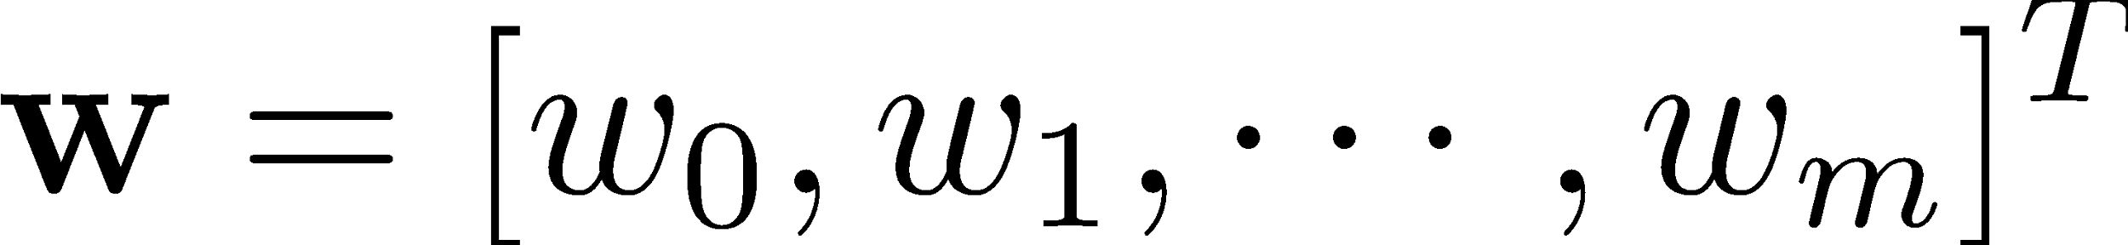
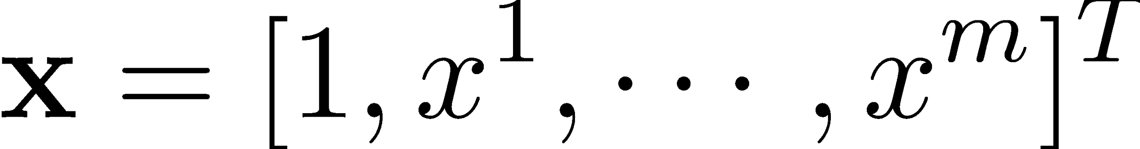
Linear Model in Disguise

Slide 12
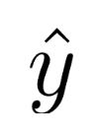
Challenge:
The above equation predicts continuous outputs.
Unbounded output: There is no natural constraint on the output, and prediction could be any real number
Intuitively, it also doesn’t make sense for to take values larger than 1 or smaller than 0 when we know that y ∈ {0, 1}.

Slide 13
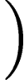
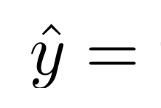
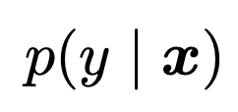
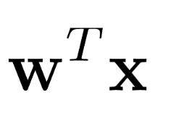
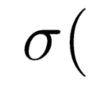
Solution
In logistic regression, we define the problem as follows:
Instead of just predicting the class, give the probability of the instance being that class
Thus we need a function that transforms the output into a probability distribution.

Slide 14
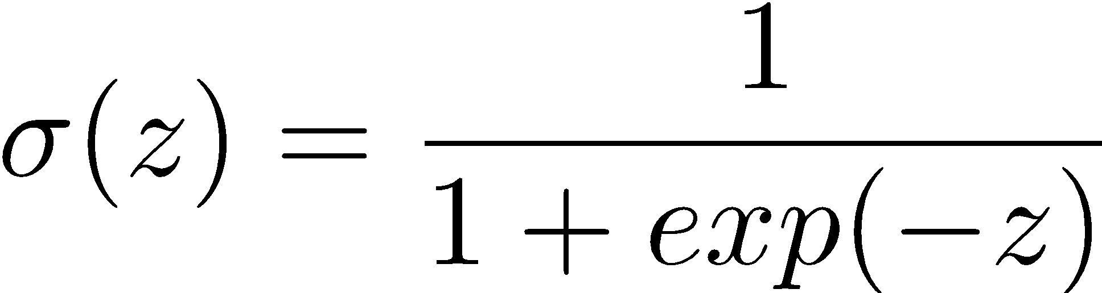
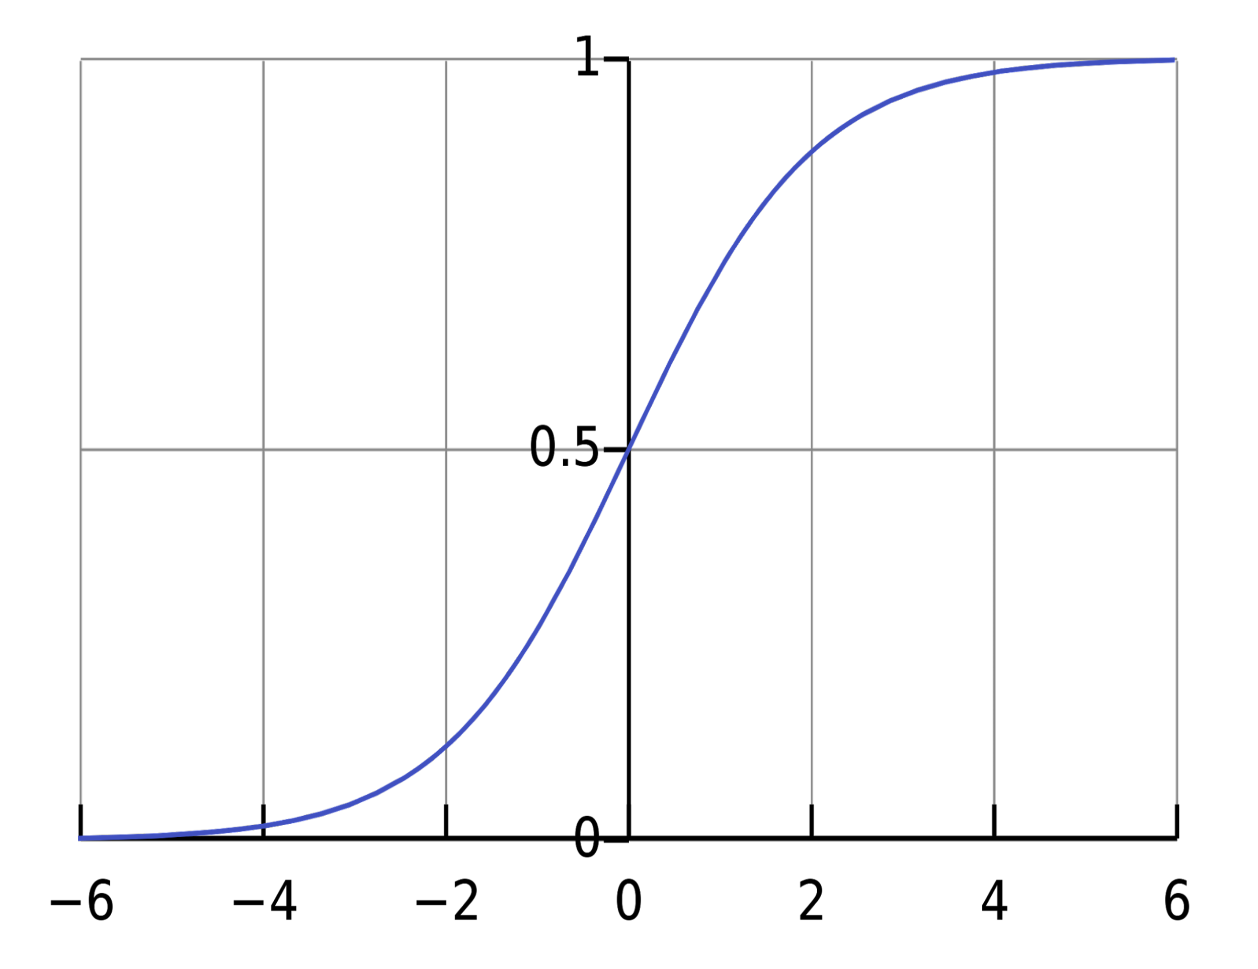
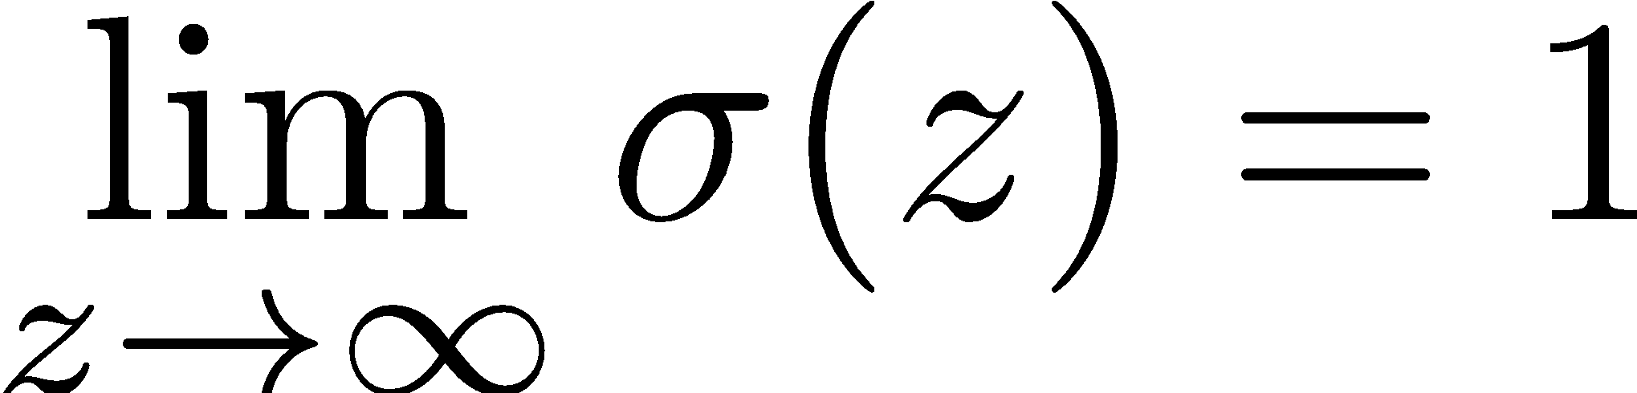
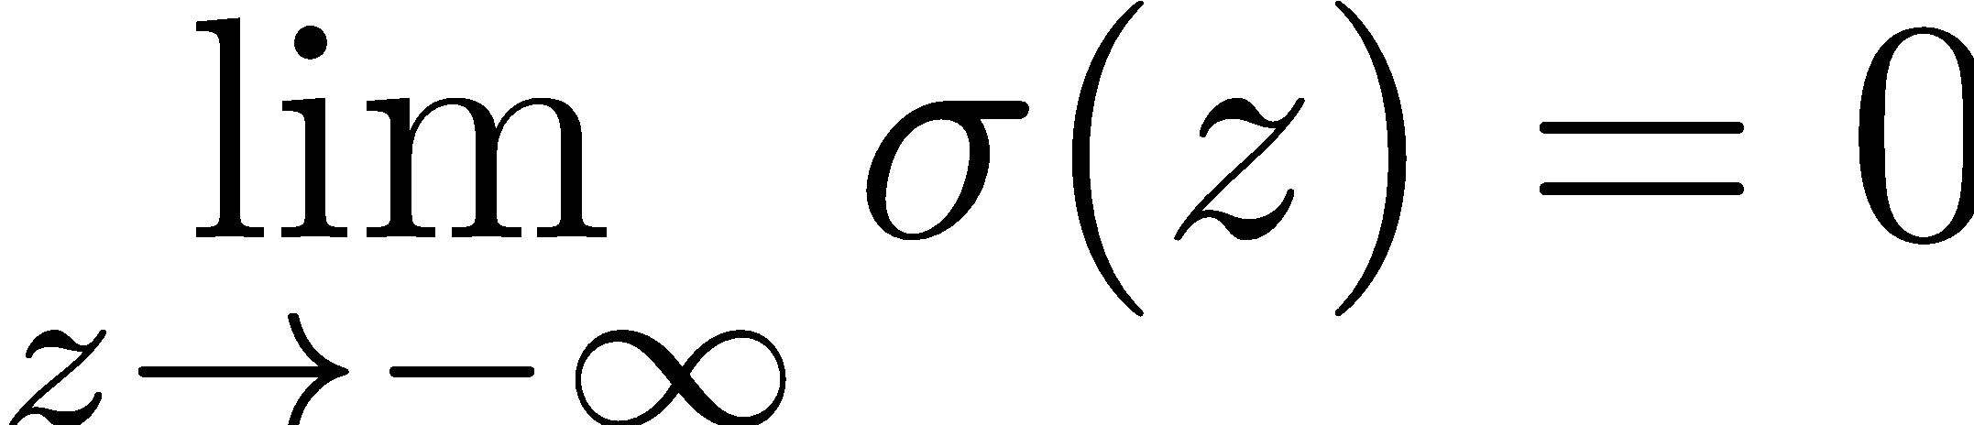
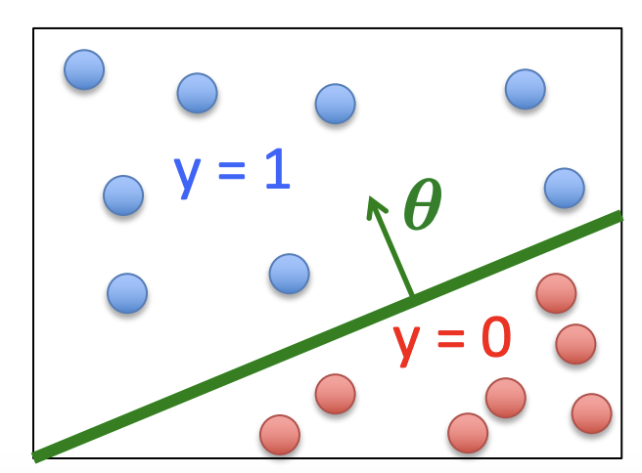
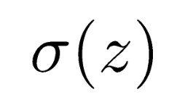
Sigmoid Function
Widely used in classification
Assume a threshold:
Predict y=1 if >= 0.5
Predict y=0 if < 0.5
Notes:
\sigma(z) = \frac{1}{1+exp(-z)} The sigmoid function transforms the linear combination θTx into a probability. If θTx is large and positive, the probability approaches 1, indicating a high confidence in class 1. Conversely, if θTx is large and negative, the probability approaches 0, indicating a high confidence in class 0.
\lim_{z \to \infty} \sigma (z) =0

Slide 15
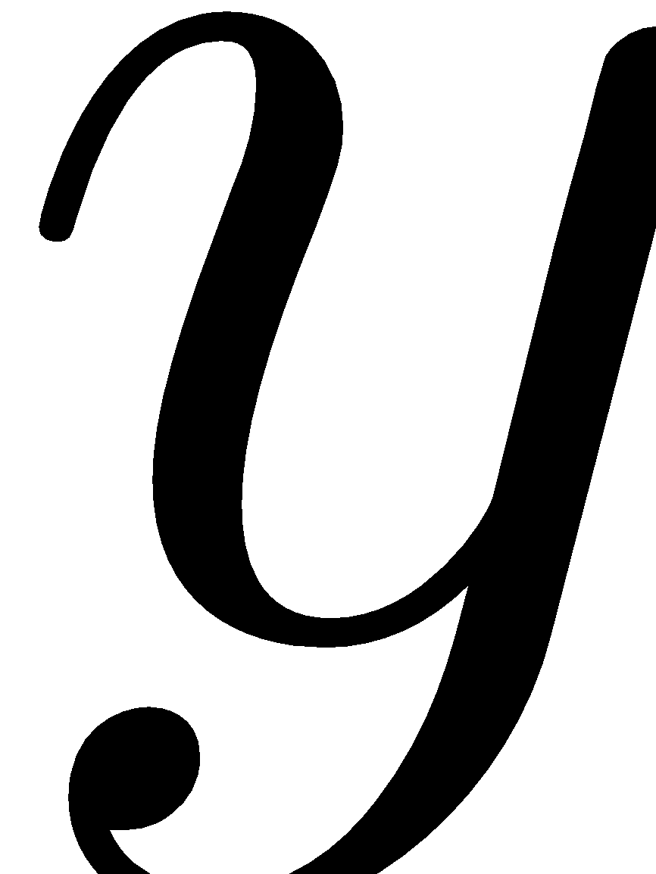

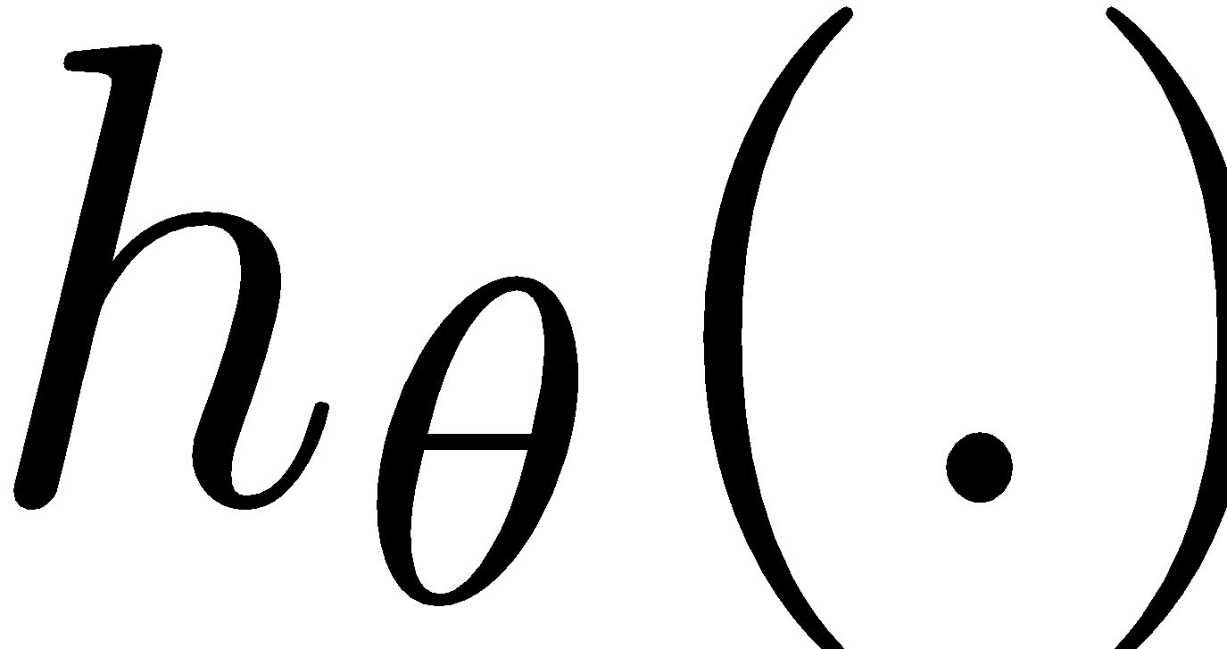
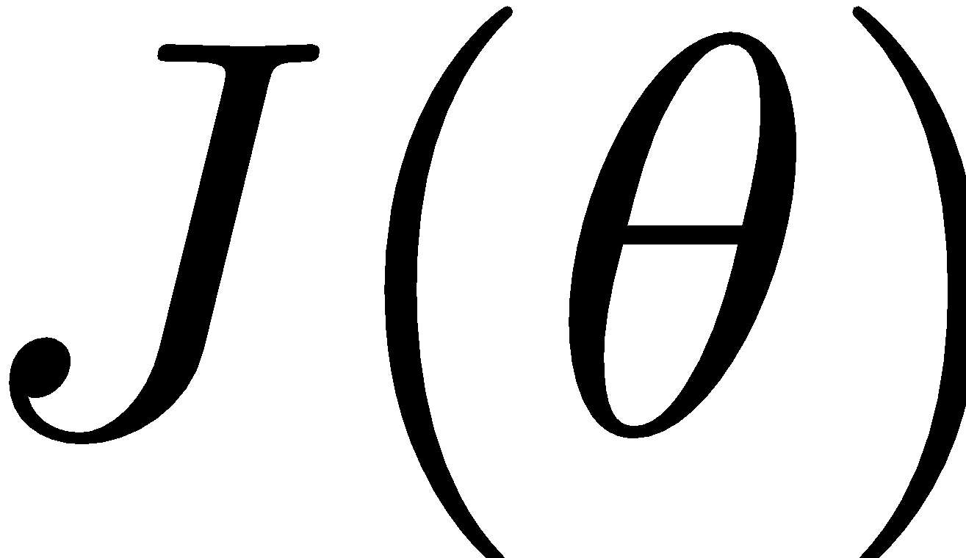
Cost Function
We want to minimize the discrepancy between our model hypothesis and the observed label.

Slide 16
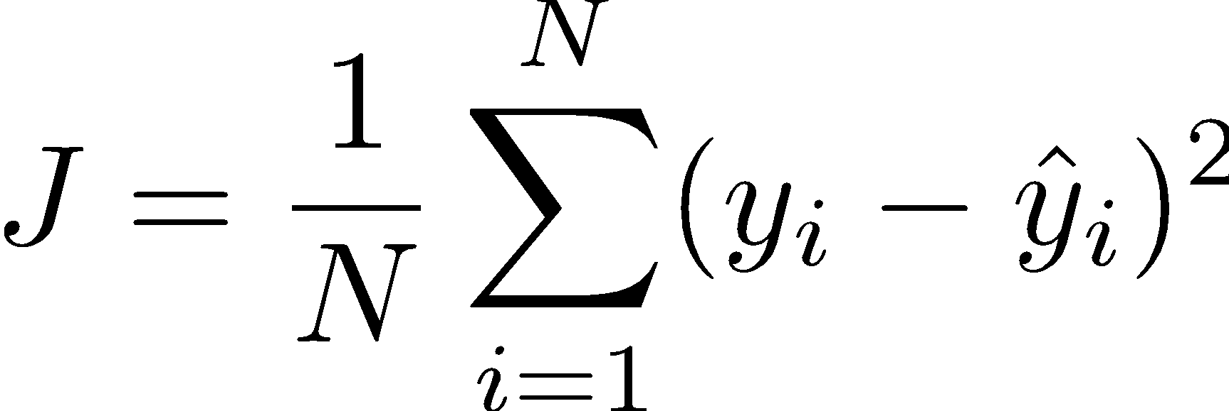
What type of loss to use?
MSE?
Not the best when it comes to classification
Leads to suboptimal results
Not ideal for probability output

Slide 17
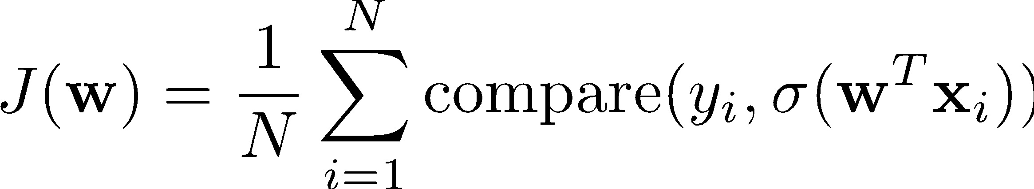
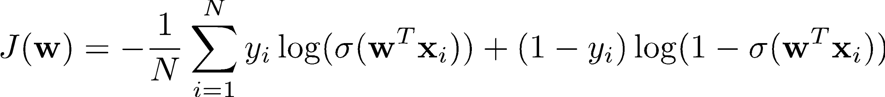
Binary Cross Entropy Loss
Notes:
J(\mathbf{w}) = \frac{1}{N}\sum_{i=1}^N \text{compare} (y_i, \sigma(\mathbf{w}^T \mathbf{x}_i))
J(\mathbf{w}) = -\frac{1}{N}\sum_{i=1}^N y_i \log(\sigma(\mathbf{w}^T \mathbf{x}_i)) + (1-y_i)\log(1-\sigma(\mathbf{w}^T \mathbf{x}_i))

Slide 18
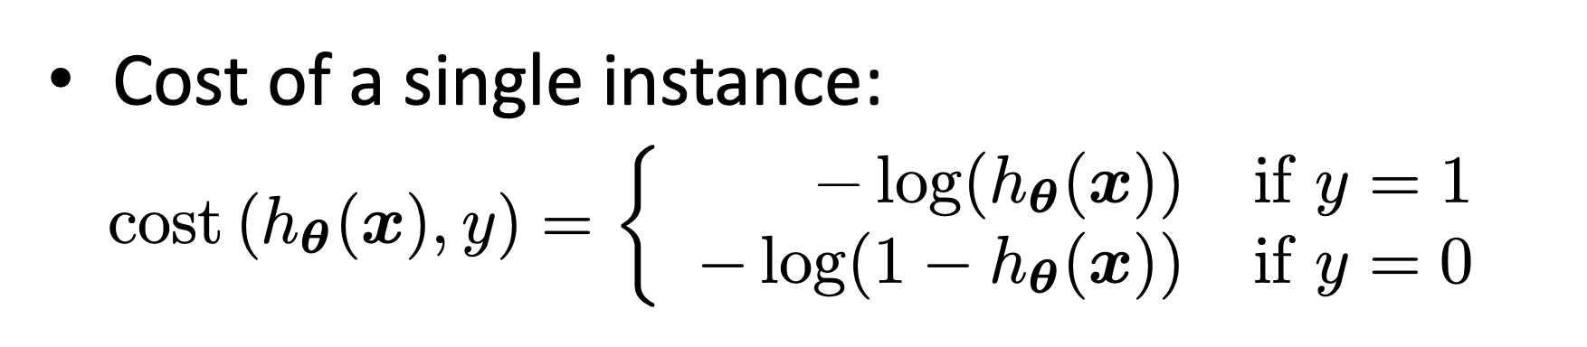
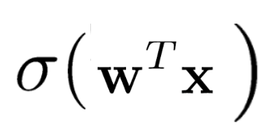
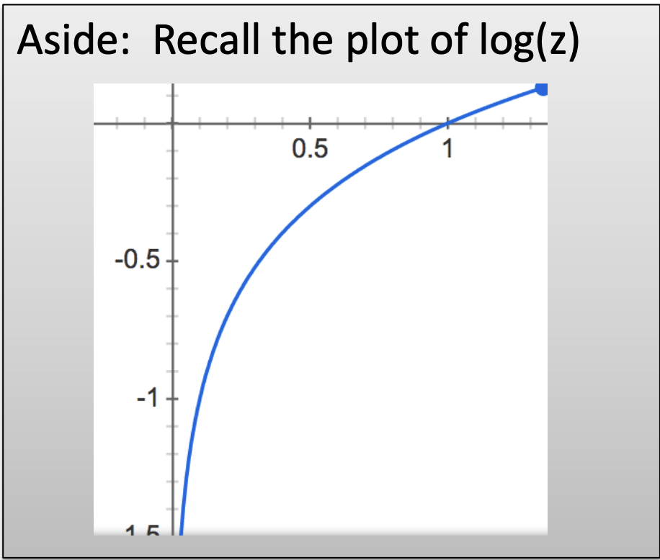
Intuition of Cost Function

Slide 19
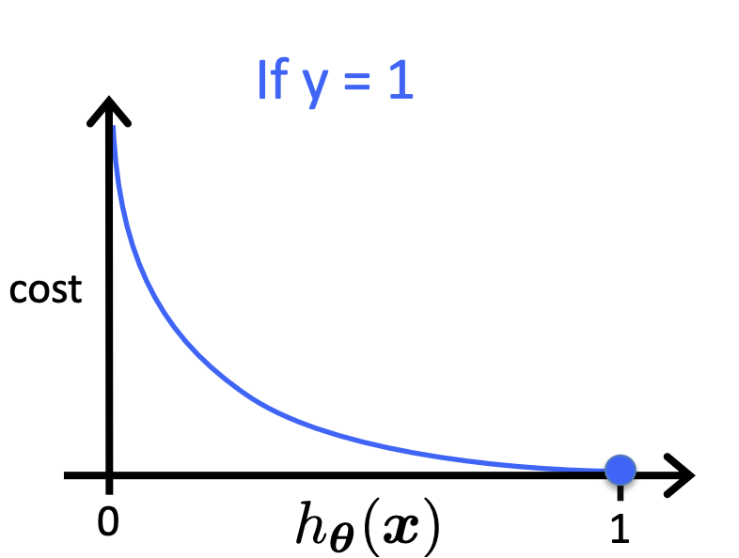
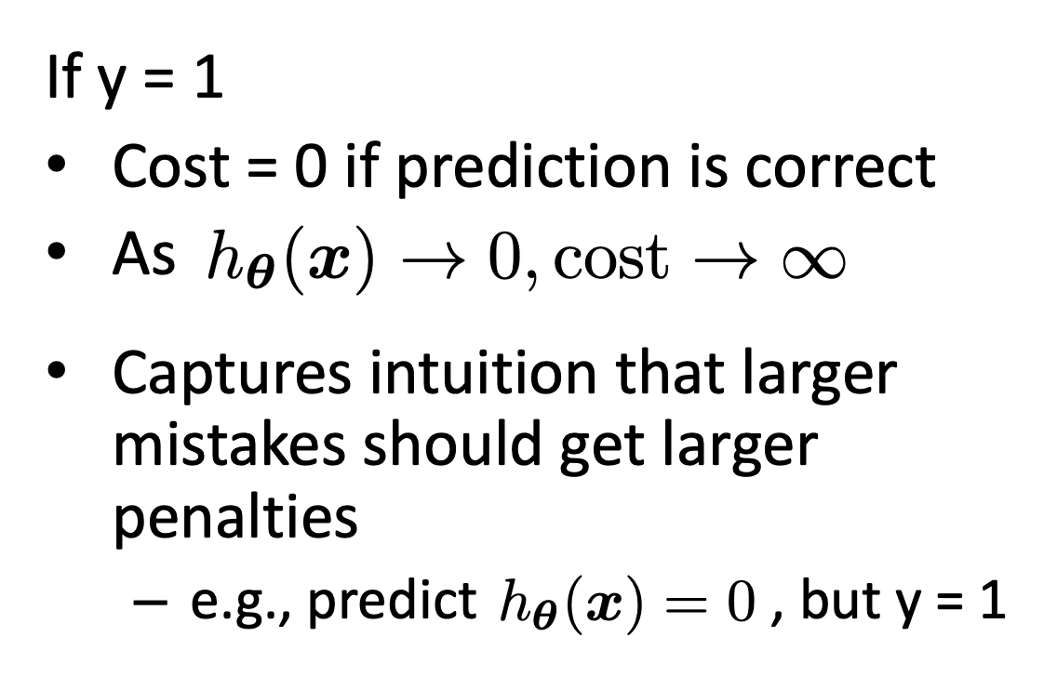
Intuition of Cost Function

Slide 20
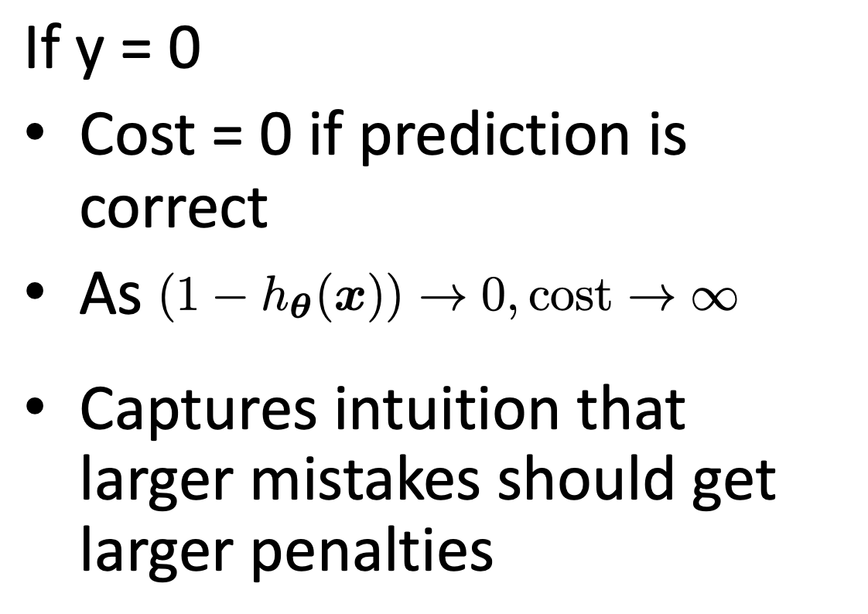
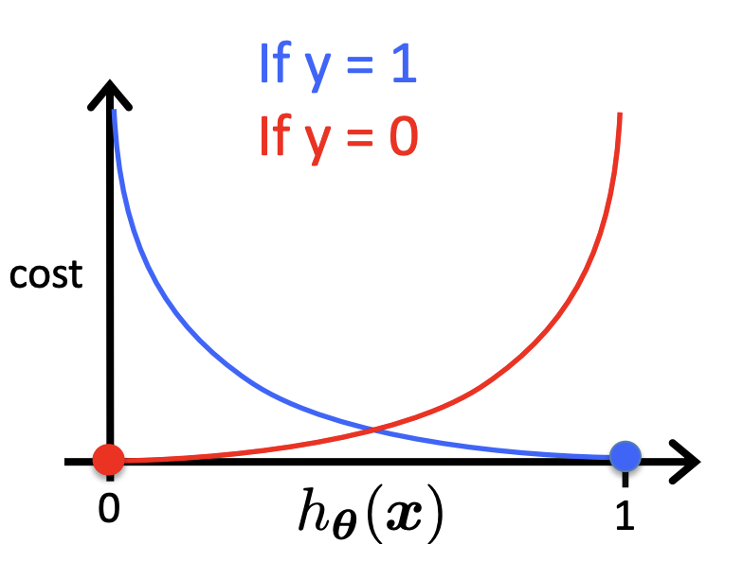
Intuition of Cost Function

Slide 21
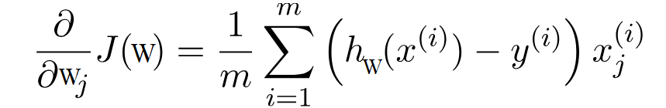
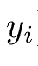
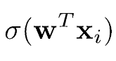
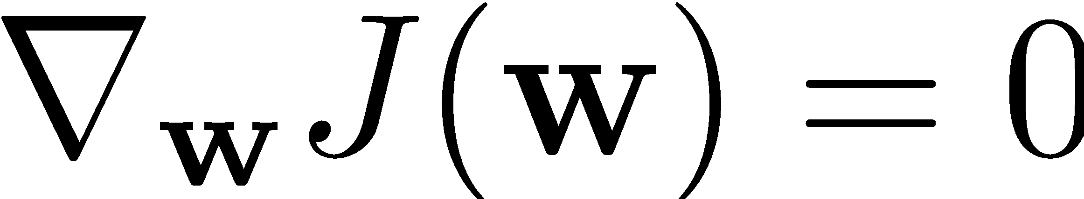
How to find optimal Parameters?
Just like before, simply take
However, this does not have a nice closed solution.

Slide 22
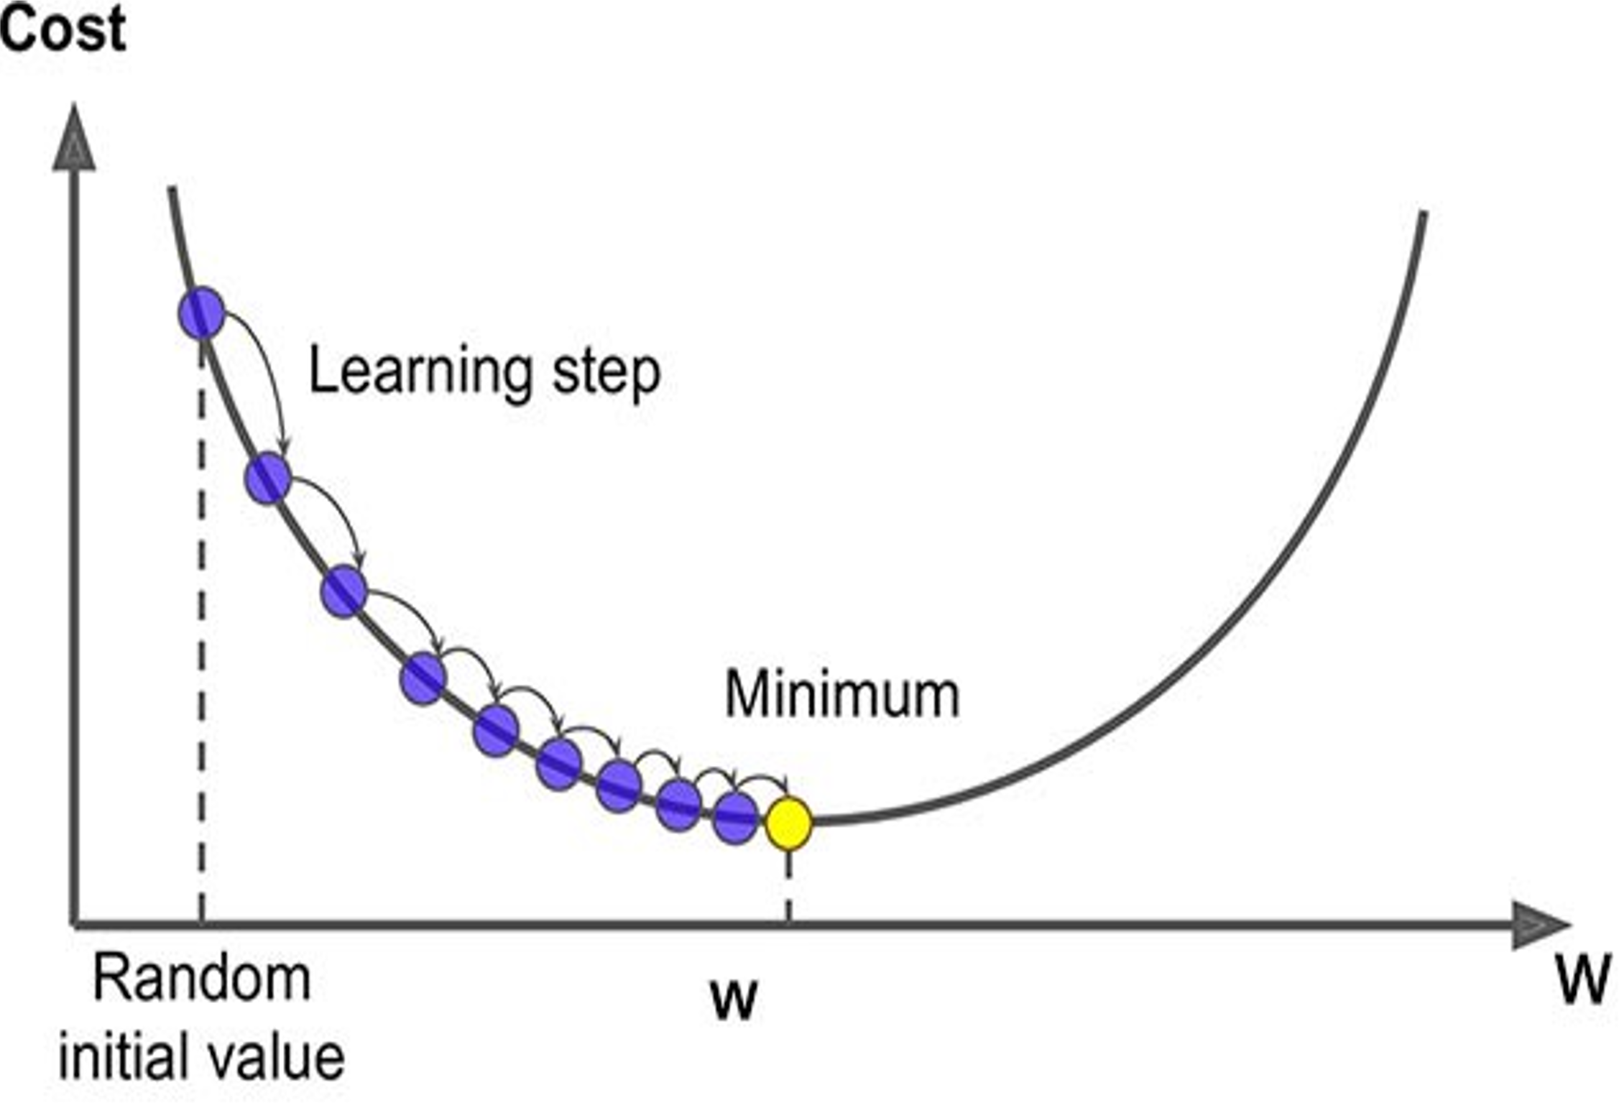
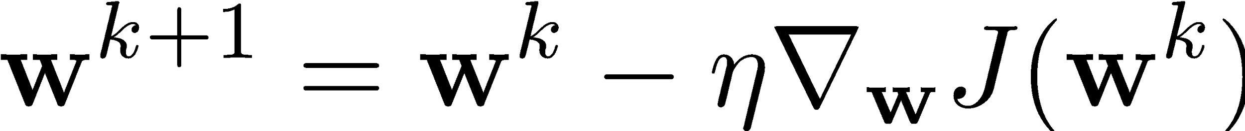
Gradient Descent
Learning rate
We have a linear model for prediction
For classification, we want to output a probability
We map the prediction to probabilities with a sigmoid function
We have a loss function (BCE) to compare models

Slide 23
Gradient Descent
Algorithm

Slide 24
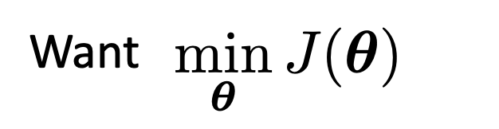
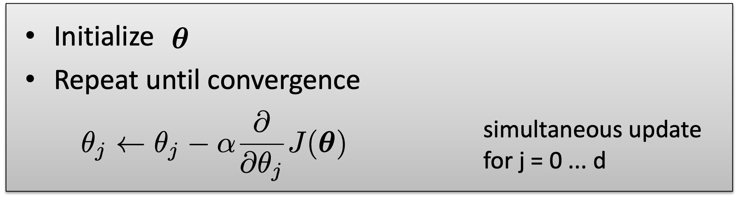
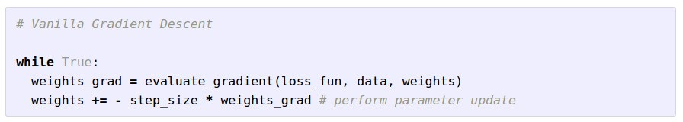
Gradient Descent
Learning rate
Notes:
\mathbf{w}^{k+1} = \mathbf{w}^{k}- \eta\nabla_{\mathbf{w}}J(\mathbf{w}^k)

Slide 25
Direction of maximum increase and decrease for a function
Gradient direction is the direction of maximum increase for a function
Negative gradient is the direction of maximum decrease for a function
Notes:
Show example

Slide 26
Gradient Descent

Slide 27
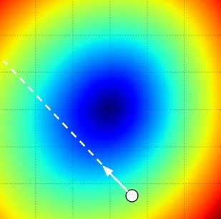
W_2
original W
W_1
negative gradient direction

Slide 28
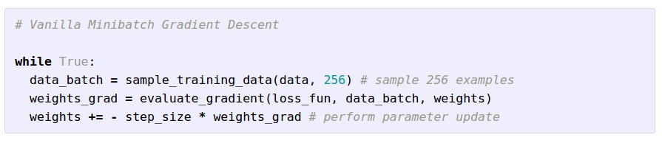
Mini-batch (Stochastic) Gradient Descent
only use a small portion of the training set to compute the gradient.
Common mini-batch sizes are 32/64/128 examples
e.g. Krizhevsky ILSVRC ConvNet used 256 examples

Slide 29
Mini-batch Gradient Descent
only use a small portion of the training set to compute the gradient.
we will look at more fancy update formulas
(momentum, Adagrad, RMSProp, Adam, …)
Common mini-batch sizes are 32/64/128 examples
e.g. Krizhevsky ILSVRC ConvNet used 256 examples

Slide 30
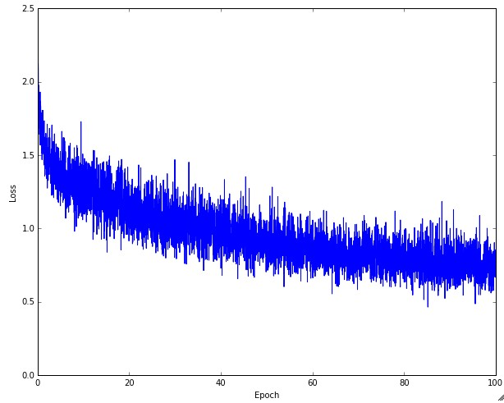
Example of optimization progress while training a neural network.
(Loss over mini-batches goes down over time.)

Slide 31

The effects of step size (or “learning rate”)

Slide 32
Minibatch updates
W_2
True negative gradient direction
W_1
original W
Slide based on CS294-129 by John Canny

Slide 33
Stochastic Gradient
W_2
noisy gradient from minibatch
W_1
original W
Slide based on CS294-129 by John Canny

Slide 34
Stochastic Gradient Descent
W_2
True gradients in blue minibatch gradients in red
W_1
original W
Gradients are noisy but still make good progress on average
Slide based on CS294-129 by John Canny

Slide 35
A Slight Detour: A Look at Optimization Tools

Slide 36
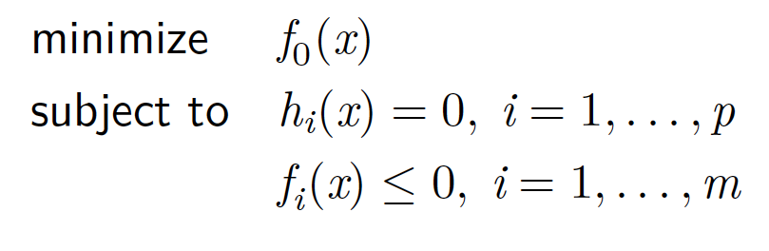
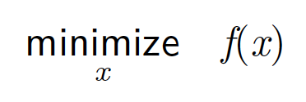
Optimization
Unconstrained Optimization
Constrained Optimization

Slide 37
Line Search Framework for Unconstrained Minimization
minimize f(x)
x
Solution Template
k = 0
choose a starting point, x⁰
while (not converged)
choose a search direction, p^{k}
choose a step size in the search direction, x^{k+1} = x^{k} + t p^{k}
k = k + 1

Slide 38
Backtracking Line Search
Simple and eﬀective strategy for line search
Reduce t incrementally: t = β t
Termination condition: f (x^{k} + tp^{k}) ≤ f (x^{k}) + αt ∇f (x^{k})^{t}p^{k}
Curvature condition automatically satisﬁed
Algorithm parameters: α and β

Slide 39
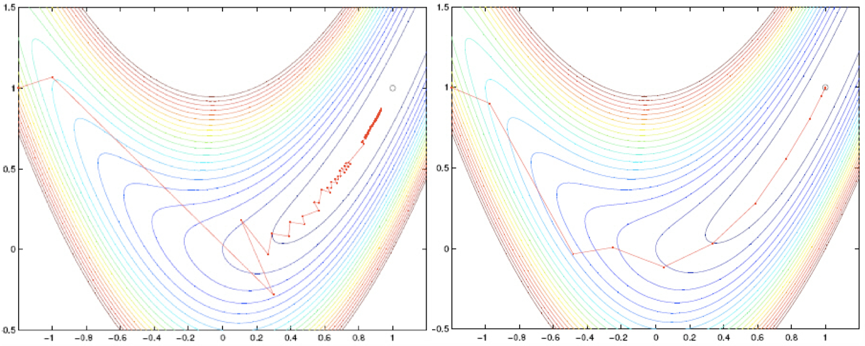
Sample Search Paths

Slide 40
Steepest Descent with Backtracking in Matlab
1 function t = backtrackLineSearch(f, gk, pk, xk)
2 a = 0.1; b = 0.8; % α and β parameters
3 t = 1;
4 while ( f(xk+t*pk) > f(xk) + a*t*gk'*pk )
5 t = b * t;
6 end
1 function [x, hist] = steepestDescentBT(f, grad, x0)
2 x = x0; hist = x0; tol = 1e-5;
3 while (norm(grad(x)) > tol)
4 p = -grad(x);
5 t = backtrackLineSearch(f, grad(x), p, x);
6 x = x + t * p;
7 hist = [hist x];
8 end

Slide 41
You might be wondering…
W_2
Standard gradient
Can we compute this?
W_1
Slide based on CS294-129 by John Canny

Slide 42
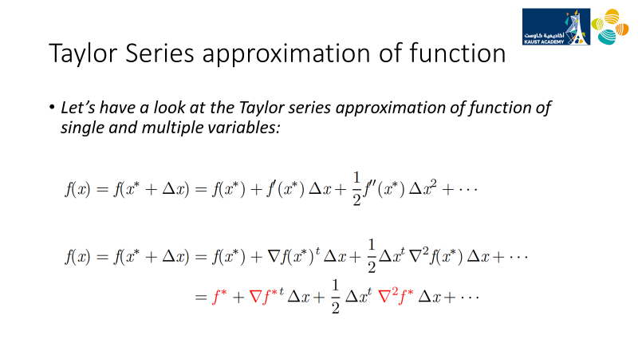

Slide 43

Newton’s method for zeros of a function
Slide based on CS294-129 by John Canny

Slide 44

Newton’s method for optima
Slide based on CS294-129 by John Canny

Slide 45

Newton’s method for gradients:
Slide based on CS294-129 by John Canny

Slide 46
Newton step
W_2
Standard gradient
Newton gradient step
W_1
Slide based on CS294-129 by John Canny

Slide 47

Newton’s method for gradients:
Slide based on CS294-129 by John Canny

Slide 48

Newton’s method for gradients:
Slide based on CS294-129 by John Canny

Slide 49

Newton’s method for gradients:
Slide based on CS294-129 by John Canny

Slide 50

L-BFGS
Slide based on CS294-129 by John Canny

Slide 51

Convergence Nomenclature
Slide based on CS294-129 by John Canny

Slide 52

Convergence Behavior
Slide based on CS294-129 by John Canny

Slide 53

Convergence Comparison
Slide based on CS294-129 by John Canny

Slide 54

Convergence Comparison
Slide based on CS294-129 by John Canny

Slide 55


Momentum update
- Physical interpretation as ball rolling down the loss function + friction (mu coefficient).
- mu = usually ~0.5, 0.9, or 0.99 (Sometimes annealed over time, e.g. from 0.5 -> 0.99)

Slide 56
Momentum update
Allows a velocity to “build up” along shallow directions
Velocity becomes damped in steep direction due to quickly changing sign

Slide 57

SGD
vs
Momentum
notice momentum
overshooting the target, but overall getting to the minimum much faster than vanilla SGD.

Slide 58
Nesterov Momentum update
Ordinary momentum update:
momentum
step
actual step
gradient
step

Slide 59
Nesterov Momentum update
Momentum update
Nesterov momentum update
“lookahead” gradient step (bit different than original)
momentum
step
momentum
step
actual step
actual step
gradient
step

Slide 60

Nesterov Momentum update
Momentum update
Nesterov momentum update
“lookahead” gradient step (bit different than original)
momentum
step
momentum
step
actual step
actual step
gradient
step
Nesterov: the only difference...

Slide 61

Nesterov Momentum update
Slightly inconvenient…
usually we have :

Slide 62

Nesterov Momentum update
Slightly inconvenient…
usually we have :
Variable transform and rearranging saves the day:

Slide 63


Nesterov Momentum update
Slightly inconvenient…
usually we have :
Variable transform and rearranging saves the day:
Replace all thetas with phis, rearrange and obtain:

Slide 64
nag =
Nesterov Accelerated Gradient

Slide 65

AdaGrad update
[Duchi et al., 2011]
Added element-wise scaling of the gradient based on the historical sum of squares in each dimension

Slide 66
AdaGrad update
Q: What happens with AdaGrad?

Slide 67
AdaGrad update
Q2: What happens to the step size over long time?

Slide 68
AdaGrad update
Q2: What happens to the step size over long time?

Slide 69

RMSProp update
[Tieleman and Hinton, 2012]

Slide 70


Introduced in a slide in Geoff Hinton’s Coursera class, lecture 6
Cited by several papers as:

Slide 71
adagrad
rmsprop

Slide 72

Adam update
[Kingma and Ba, 2014]
(incomplete, but close)

Slide 73
Adam update
[Kingma and Ba, 2014]
(incomplete, but close)
momentum
RMSProp-like
Looks a bit like RMSProp with momentum

Slide 74
Adam update
[Kingma and Ba, 2014]
(incomplete, but close)
momentum
RMSProp-like
Looks a bit like RMSProp with momentum

Slide 75

Adam update
[Kingma and Ba, 2014]
momentum
bias correction
(only relevant in first few iterations when t is small)
RMSProp-like
The bias correction compensates for the fact that m,v are initialized at zero and need some time to “warm up”.

Slide 76
SGD, SGD+Momentum, Adagrad, RMSProp, Adam all have learning rate as a hyperparameter.
Q: Which one of these learning rates is best to use?

Slide 77


SGD, SGD+Momentum, Adagrad, RMSProp, Adam all have learning rate as a hyperparameter.
=> Learning rate decay over time!
step decay:
e.g. decay learning rate by half every few epochs.
exponential decay:
1/t decay:

Slide 78
Summary
Simple Gradient Methods like SGD can make adequate progress to an optimum when used on minibatches of data.
Second-order methods make much better progress toward the goal, but are more expensive and unstable.
Convergence rates: quadratic, linear, O(1/n).
Momentum: is another method to produce better effective gradients.
ADAGRAD, RMSprop diagonally scale the gradient. ADAM scales and applies momentum.

Slide 79

The effects of different update formulas
(image credits to Alec Radford)

Slide 80
Questions?

